Slide 1
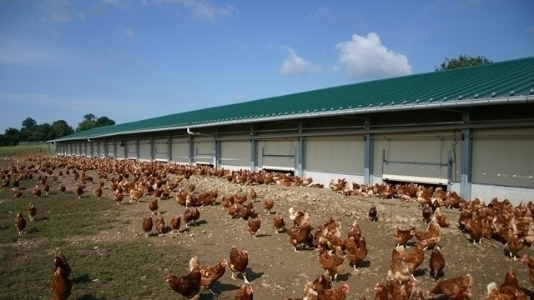
Henhouse

Slide 2

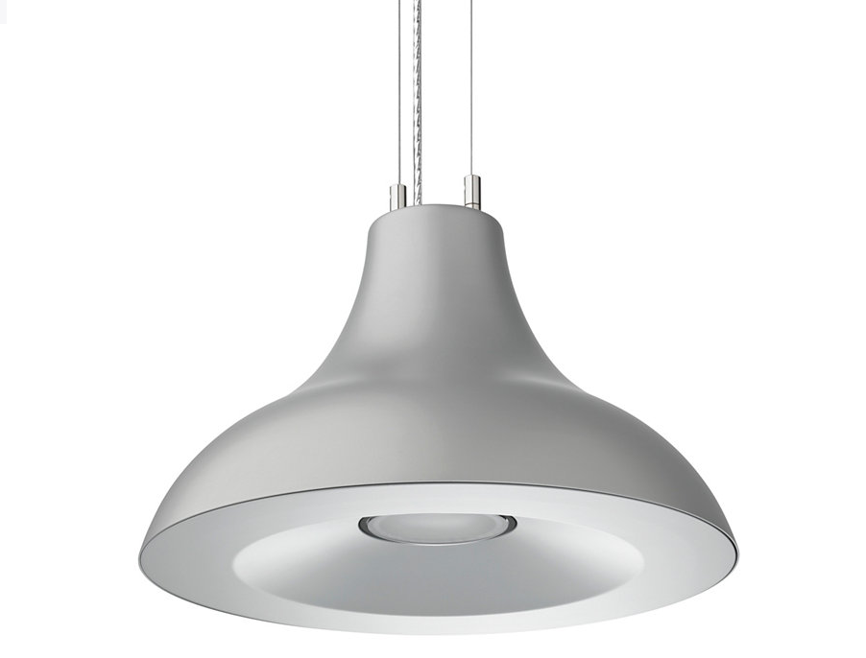
Lamps of 40 lux
2700 lm
30 w

Slide 3


Dialux

Slide 4
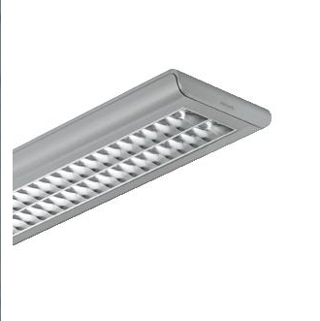
Lamps 300 lux

Slide 5
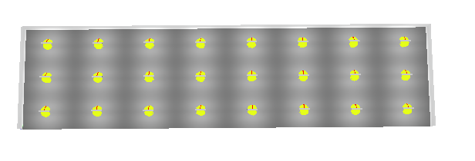

Dialux

